Slide 1
Introduction to Data Modeling

Slide 2
What is a Data Model?
Data modeling is often the first step in database design as the designers first create a conceptual model of how data items relate to each other.
Data modeling involves a progression from conceptual model to logical model to physical schema.

Slide 3
Rationales for Data Modeling
Data is the foundation of modern information systems enabled by data base technologies.
Data in an organization exist and can be described independently of how these data are used.
Data should be managed as a corporate-wide resource.
The types of data used in an organization do not change very much.

Slide 4
Database Design Process
Requirement collection and analysis
  DB requirements and functional requirements
Conceptual DB design using a high-level model
  Easier to understand and communicate with others
Logical DB design (data model mapping)
  Conceptual schema is transformed from a high-level data model into implementation data model
Physical DB design
  Internal data structures and file organizations for DB are specified
Notes:
2

Slide 5
Types of data models:
  Conceptual: describes WHAT the system contains, independent of DBMS
  Logical: describes HOW the system will be implemented, DBMS dependent
  Physical: HOW the system will be implemented on storage structure

Slide 6
Why do we need to create data models?
To aid in the development of a sound database design that does not allow anomalies or inconsistencies
Goal: to create database tables that do not contain duplicate data values that can become inconsistent

Slide 7
Types of Data Models
Entity-Relationship (E-R) Models
  Only addresses data and relationships
  simple
  Best for deriving a sound table design
  Many extensions/variations exist
UML (unified modeling language)
  Class models
  Goes beyond data, also models behaviors

Slide 8
Creating an Entity-Relationship Model
Identify entities
Identify entity attributes and primary keys
Specify relationships

Slide 9
Data Entities
Entity
“An entity is a business object that represents a group, or category of data.”¹
  A "thing" about which you want to store data in an application
  Multiple examples (instances) of the entity must exist
  Goal:
    Store data about each entity in a separate table
    Do not store duplicate data in multiple tables or records
  Examples: CUSTOMER, PRODUCT

Slide 10
Data Entity Instances
Entity instance
  A specific occurrence (data value) of an entity
  An entity must have multiple entity instances or it is not really an entity!
  Examples: Course: course#, title, semester, ..
  CSC281 …
  CSC330 …
  CSC570 …

Slide 11
Entity Type and Entity Instance (Occurrence)
Entity Types Entity Instance
Vendor ABC Co.
Employee John Smith
Course Intro. to IE
Department Marketing Department

Slide 12
Example of Entity Type Descriptions
Entity Type
Description
Customer
Information about all persons or organizations who purchases
Product
All goods manufactured and sold
Raw-material
Components used to manufacture Products.
Supplier
Vendors of Raw Materials.
Buyer
Company personnel responsible for purchasing Raw-Materials from Suppliers

Slide 13
Finding Entity Types
Interviews with users
Business forms
Reports
Computer files using reverse engineering
Operation manuals
Similar/Published works
Generic Model

Slide 14
Where to Look for an Entity Type?
Tangible or Intangible Things
  The nouns that are used to describe the problem domain will often correspond to the major Entity Types of the system, at least at a high level.
  Examples: Product, Sensor, and Employee, Department, and Sale Office.
Resources
  Any resources that an organization needs to manage should be represented as an Entity Type. Information assists the efficient and effective use of other resources through improved decision.
  Examples: Inventory, Machine, Bank Account, and Customer.
Roles Played
  Roles can be played by persons or organizational units.
  Examples: Customers, Managers, and Account representatives.
Events
  Events are incidents that occur at points in time. An event often involved an interaction between two Entity Types or an action that changes the status of an Entity Type.
  Examples: Sale, Delivery, and Registration of a motor vehicle.

Slide 15
Attributes
Definition
“An attribute is a sub-group of information within an entity.”
  Characteristics that could be used to describe Entity Types and Relationship Types.
Examples
  Customer has customer name, address, and telephone number
  Product has quantity-on-hand, weight, volume, color, and name.
  Employee has SSN, salary, and birthday.
  Employee-works-for-project has percentage-of-time, starting-date.`

Slide 16
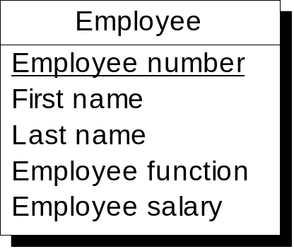
Attributes: Notations
Student ID
Student
Student
Student Name
studentID
Birth date
Student ID
name
phone
enrollment
Course no.
Birth date
Student(Student ID, Student Name, Birth Date)

Slide 17
Attribute Source Categories
Basic
  Definition: An Attribute Value that cannot be deduced or calculated.
  Examples: Student name and Birthday
Derived
  Definition: The Attribute Value can be calculated or deduced from relationship Groupings or from the values of other Attributes. The value of a Derived Attribute changes constantly.
  Examples: Student Age, Account Balance, Number of courses taken.
Designed
  Definition: The Attribute is created to overcome the system constraints. The value of a Designed Attribute does not change.
  Examples: Student ID, Course number.

Slide 18
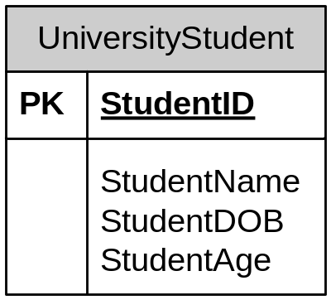
ER Model Notation
Represent entities as rectangles
List attributes within the rectangle
Entity
Primary key
Attributes

Slide 19
Relationship (Type)
Definition
  A Relationship Type is an association among Entity Types. It indicates that there is a business relationship between these Entity Types.
  Relationship Membership is the participation of an Entity Type in a Relationship.
  In ER, a Relationship Type can involve only two Entity Types (binary relationship). Some other modeling techniques allow n-ary relationships.
Examples
  CUSTOMER places ORDER
  ORDER is placed by CUSTOMER
  EMPLOYEE works on PROJECT
  PROJECT has project member EMPLOYEE

Slide 20
Data Model Relationships
Specify the number of instances of one entity that can be associated with instances of a related entity
Types:
  1:1
  1:M
  M:M
  “M” denotes some value greater than 1 whose upper bound is undetermined
  This is called relationship cardinality

Slide 21
Relationship Cardinality
E1
E2
One-to-One
1:1
One-to-Many
E1
E2
1:M
Many-to-Many
E1
E2
M:N

Slide 22
Relationship Cardinality
The number of Entity Instances involved in the Relationship Instances Grouping in a Relationship Type.
Three Forms of Cardinality
1. One-to-one (1:1)
DEPARTMENT has MANAGER
Each DEPARTMENT has one and only one MANAGER
Each MANAGER manages one and only one DEPARTMENT
2. One-to-many (1:m)
CUSTOMER places ORDER
Each CUSTOMER sometimes (95%) place one or more ORDERs
Each ORDER always is placed by exactly one CUSTOMER
3. Many-to-many (m:n)
INSTRUCTOR teaches COURSE
Each INSTRUCTION teaches zero, one, or more COURSEs
Each COURSE is taught by one or more INSTRUCTORs

Slide 23
Example 1:1 Relationship
Spouse
Spouse_ID
Spouse_Name
Spouse_ID | Spouse_Name
52 | Ryan, Judy
53 | Redmann, Rudy
Has
Customer
Customer_ID
Customer_Name
Customer_Address
Customer_ ID | Customer_ Name | Customer_Address
1 | Ryan, Paul | 5454 Hyde Court
2 | Myers, Mary | 112 Birch Place

Slide 24
Example 1:M Relationship
Store
Store_ID
Store_Name
Store_Address
Store_ID | Store_Name | Store_Address
1 | Northside | 3233 Wisconsin St.
2 | Southside | 4211 Golf Road
Rents
Video_ID | Video_Title | Video_Format
1000 | The Princess Bride | DVD
1001 | Sideways | Bluray
1002 | Just Visiting | DVD
1003 | Crash | Bluray
Video
Video_ID
Video_Title
Video_Format

Slide 25
Example M:M Relationship
Video
Video_ID
Video_Title
Rents
Customer
Customer_ID
Customer_Name
Customer_Address

Slide 26
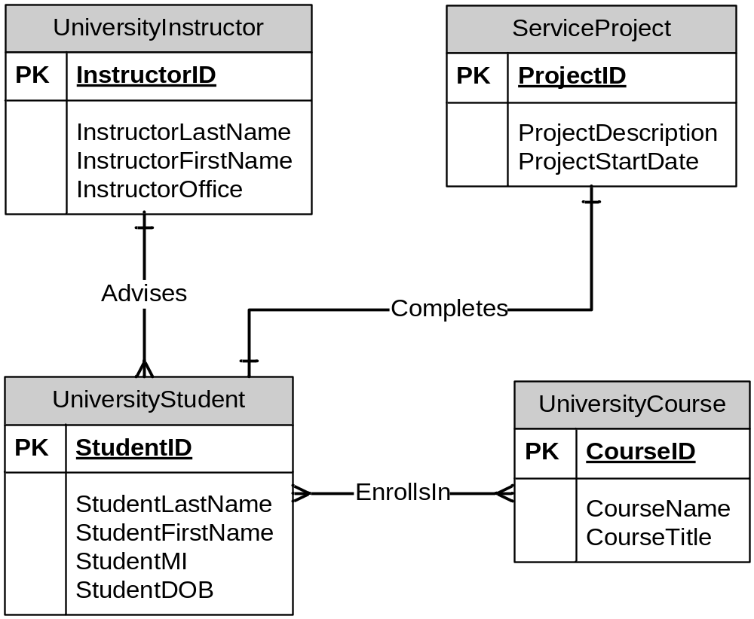
Example: ER Model

Slide 27
Example: ER Model
Team
Team number
Specialty
Customer
Customer number
member
Customer name
is a member of
Customer address
Customer activity
Customer telephone
Division
Employee
Customer fax
Division number
Employee number
Division name
belongs to
First name
Division address
Last name
subcontract
Employee function
Employee salary
staffed by
is assigned to
Project
Project number
Project name
Task
Project label
Task name
contains
Start date
Task cost
End date

Slide 28
Optionality of Relationship Memberships
Whether all entity instances of both entity types need to participate in relationship pairing.
Optionality:
  Mandatory
  Optional
Example:
  CUSTOMER membership is optional
  ORDER membership is mandatory
places
CUSTOMER
ORDER
is placed by

Slide 29
Recursive Relationship
EMPLOYEE
supervises
is supervised by

Slide 30
Relationship Statements
Cardinality
indicator
one
one or more
Graphical Notations
places
CUSTOMER
ORDER
is placed by
Optionality
indicator
zero (sometimes)
one (always)
Each Entity X optionality relationship cardinality Entity Y
Each CUSTOMER sometimes places one or more ORDER.
Each ORDER always is placed by one CUSTOMER.

Slide 31
ERD: More Examples
(a)
places
Customer
Order
belongs-to
is-contained-in
Product
contains
(b)
manages
Parallel
Relationship
Employee
Project
is-managed-by
works-for
has-project-members
is-consists-of
(c)
Involuted or Looped
Relationship
Part
contained-in

Slide 32
Identifying Relationships
Association between entity types
Entity types that are used on the same forms or documents.
A description in a business document that has a verb that relates two entity types
  has
  consists of
  uses

Slide 33
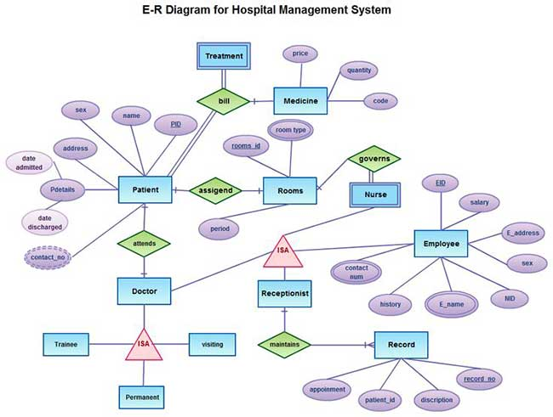

Slide 34

ER DIAGRAM – Relationship Types are:
WORKS_FOR, MANAGES, WORKS_ON, CONTROLS, SUPERVISION, DEPENDENTS_OF
Slide 3- <number>

